Slide 1
CAPSTONE PROJECT - (regression)
Bike Sharing Demand Prediction
By
Ankur Nain

Slide 2

Content
Problem Statement
Data Summary
Ride Origination Towns
Travel time
Analysis Details 2
Quarterly Trend
Month wise booking trends
Hourly Travel Trend
Day wise Travel Trend
Feature Engineering
ML Models and Metrics
Challenges
Conclusion

Slide 3

Problem Statement
Exploring 14 different towns to the North-West of Nairobi towards Lake Victoria and using the data provided by bus ticket sales from Mobiticket, predicting the number of tickets that will be sold for buses that ends into Nairobi.

Slide 4
Data Summary
This dataset includes the variables from 17 October 2017 to 20 April 2018
ride_id: unique ID of a vehicle on a specific route on a specific day and time.
seat_number: seat assigned to ticket
payment_method: method used by customer to purchase ticket from Mobiticket
payment_receipt: unique id number for ticket purchased from Mobiticket
travel_date: date of ride departure. (MM/DD/YYYY)
travel_time: scheduled departure time of ride. Rides generally depart on time. (hh:mm)
travel_from: town from which ride originated
travel_to: destination of ride. All rides are to Nairobi.
car_type: vehicle type (shuttle or bus)
max_capacity: number of seats on the vehicle

Slide 5
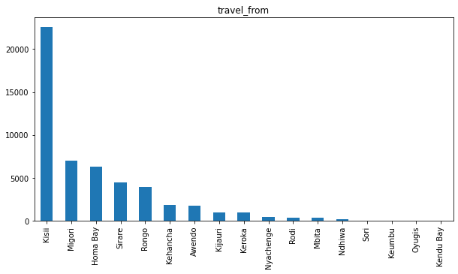
Ride Origination Towns
Kisii is the top place from where the most number of rides originate.

Slide 6
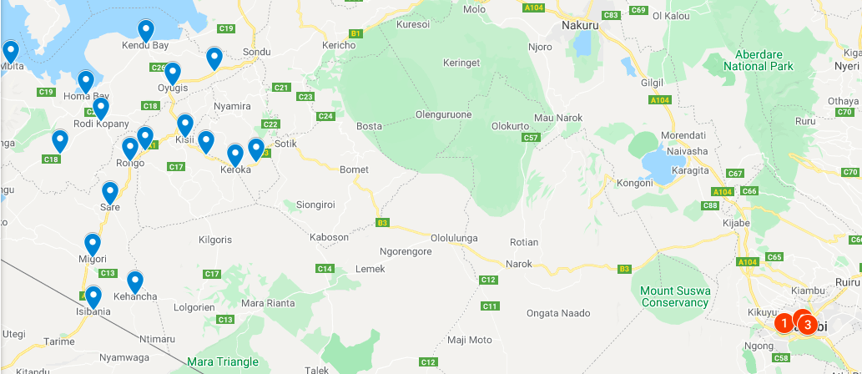
Map

Slide 7
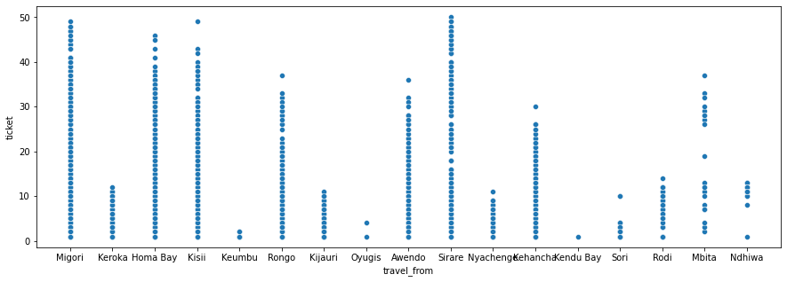
EDA
Scatter plot of travel_from by number of tickets

Slide 8
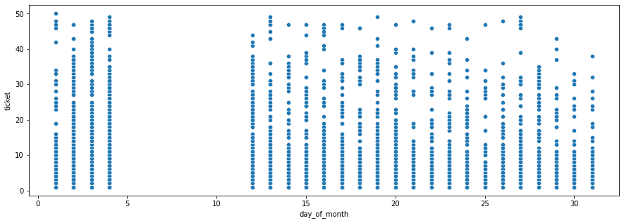
Day wise Travel Trend
The frequency of the rides are almost similar among the days of the month,
There are no rides between 4th to 11th of every month,but this might be because of missing data

Slide 9
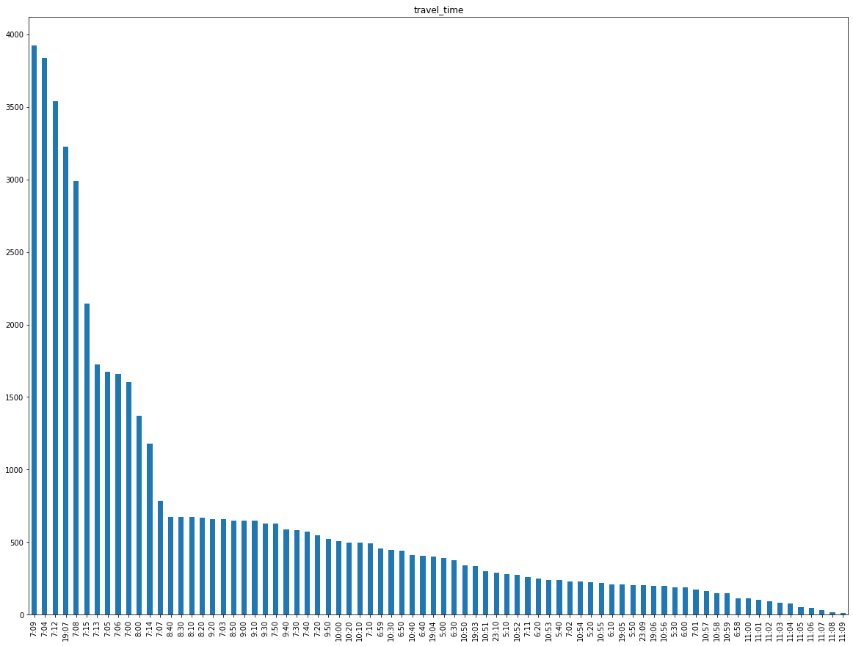
Departure Time
Highest number of buses depart at around 7 AM in the Morning

Slide 10
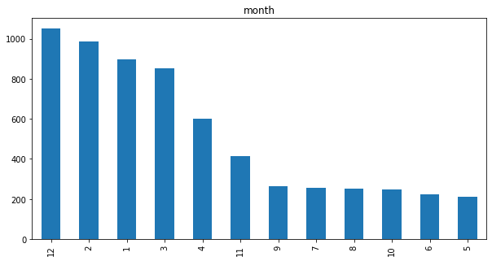
Month-wise Rides Trends
During the month of December,February and January there are more number of rides, and least during the months of May and June

Slide 11
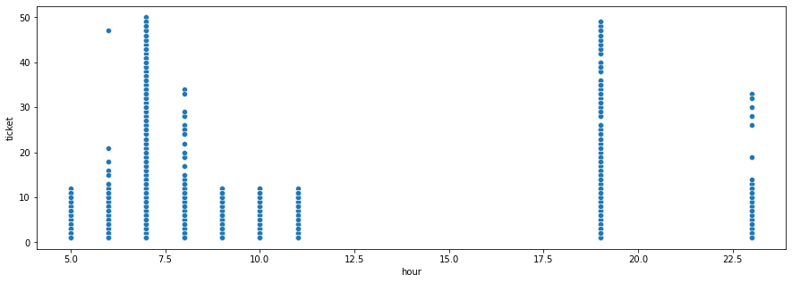
Hourly Travel Trend
The frequency of rides are more in the Morning hours and during the night times

Slide 12
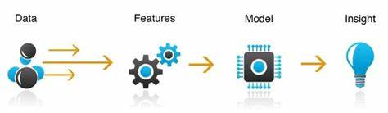
Feature Engineering
Using domain knowledge to extract features from raw data, the performance of the model can be improved.
Speed
Travel_month
No_of_tickets
travel_day
hod_arrived_date
Is_rush_hour
Travel_from
Time_gap_between_buses
Travel_from_distance
hourly_travelers
daily_travelers

Slide 13
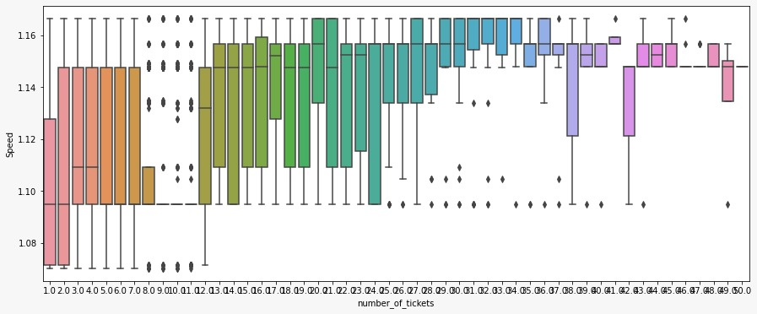
Variation of Number of Tickets with Speed

Slide 14
ML Models and Metrics
TYPE OF REGRESSION | Train Score | Test Score | R2 SCORE | ADJ_R2 | MAE | MSE
LINEAR | 0.41531 | 0.354621 | 0.354679831 | 0.3476561 | 4.7474791 | 48.4351195
LINEAR-LASSO | 0.393599 | 0.343606 | 0.355067 | 0.3487478 | 4.7417715 | 48.4241544
LINEAR-RIDGE | 0.405354 | 0.3553535 | 0.3550673 | 0.3481087 | 5.026478 | 48.4015719
GRADIENT BOOSTING | 0.676331137 | 0.60851 | 0.6085084 | 0.6046721 | 3.540035 | 29.3904512
RANDOM FOREST | 0.62637829 | 0.623421 | 0.6234206 | 0.6152057 | 3.4301030 | 28.2619184
XGBOOST | 0.84559453 | 0.84211254 | 0.84211254 | 0.8386682 | 2.2667203 | 11.8493008

Slide 15
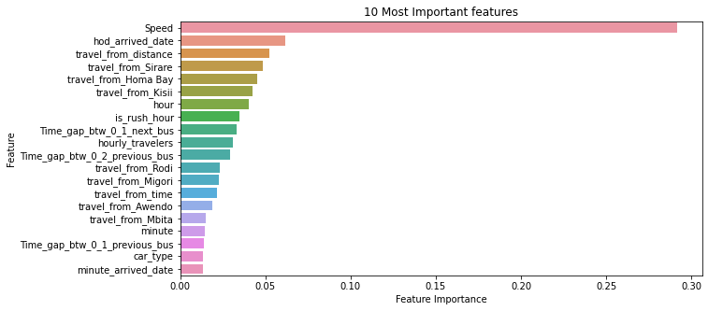
Feature Importance

Slide 16
Challenges
Feature engineering
To the dependent variable
Filtering discrete values
Feature selection

Slide 17
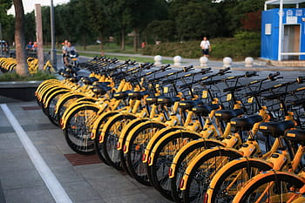
Conclusion
This resulting model can be used by Mobiticket and bus operators to anticipate for the tickets for certain rides. We have compared the performance of six different regression models. XGBoost regression model performed the best among them including the ensemble model proposed with the lowest error rate. We pre-processed data to apply regression models for forecasting the speed of vehicles and distance between the source and destination.

